Slide 1
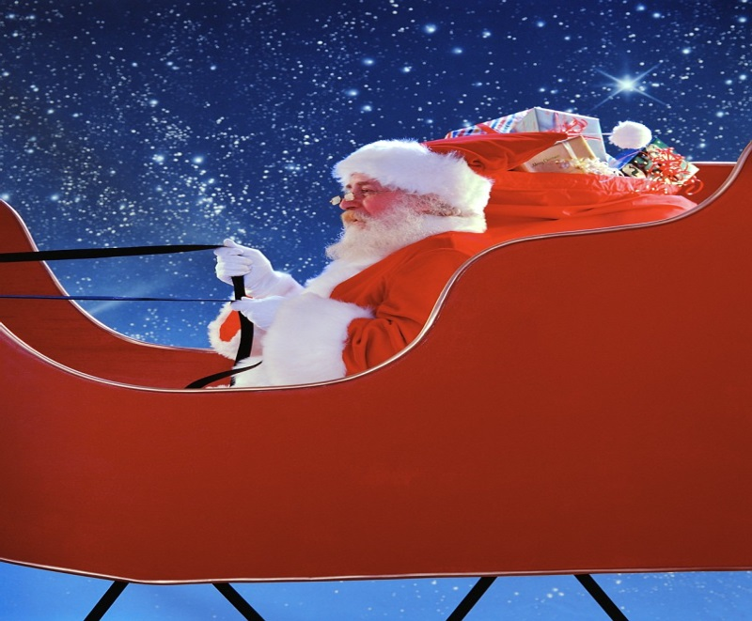
You are invited
The Land of Lincoln Chapter invites you to our 6th annual Toys for Tots event
Tuesday, December 16th
Mariah’s
5:30 – 7:30
Featuring the Horace Mann Singers
Spouses/guests welcome
Cost $25.00 per person
Please help a child by donating an unwrapped toy
Contributions made be made in cash or check to
Toys for Tots
RSVP by Monday, December 8th

